Slide 1
MGT388 Finance for Engineers
Lecture 4
Costing:
Definition, classification and absorption costing

Slide 2
Lecture Outline
The concept of cost
Costing: definition and purposes
Cost classification
Absorption costing with one product made in a production department
Absorption costing where one product passes through more than one production department

Slide 3
The concept of cost
Cost: is a resource sacrificed or foregone to achieve a specific objective.
Cost = expenditure incurred
but there is often more than one answer
e.g.: historical cost versus replacement cost;
full cost versus marginal cost;
actual costs versus budgeted costs.
Which Costing method?
depends upon the decision you are trying to make

Slide 4
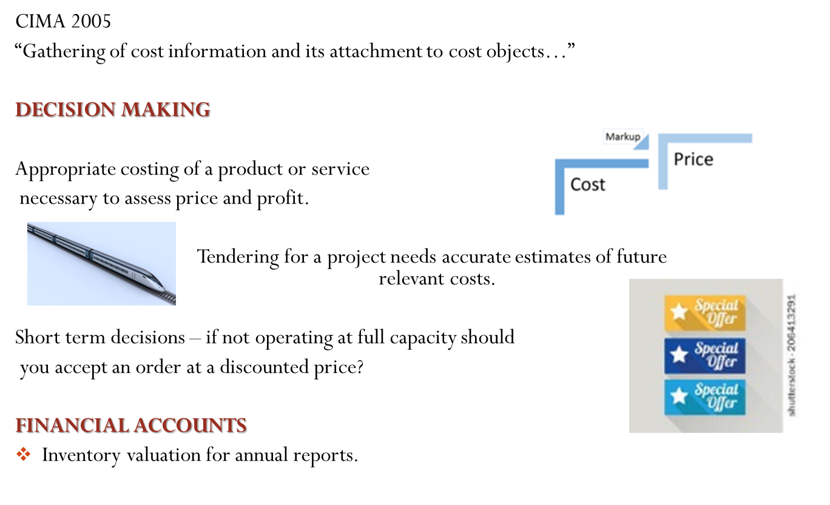
Costing: definition and purposes

Slide 5
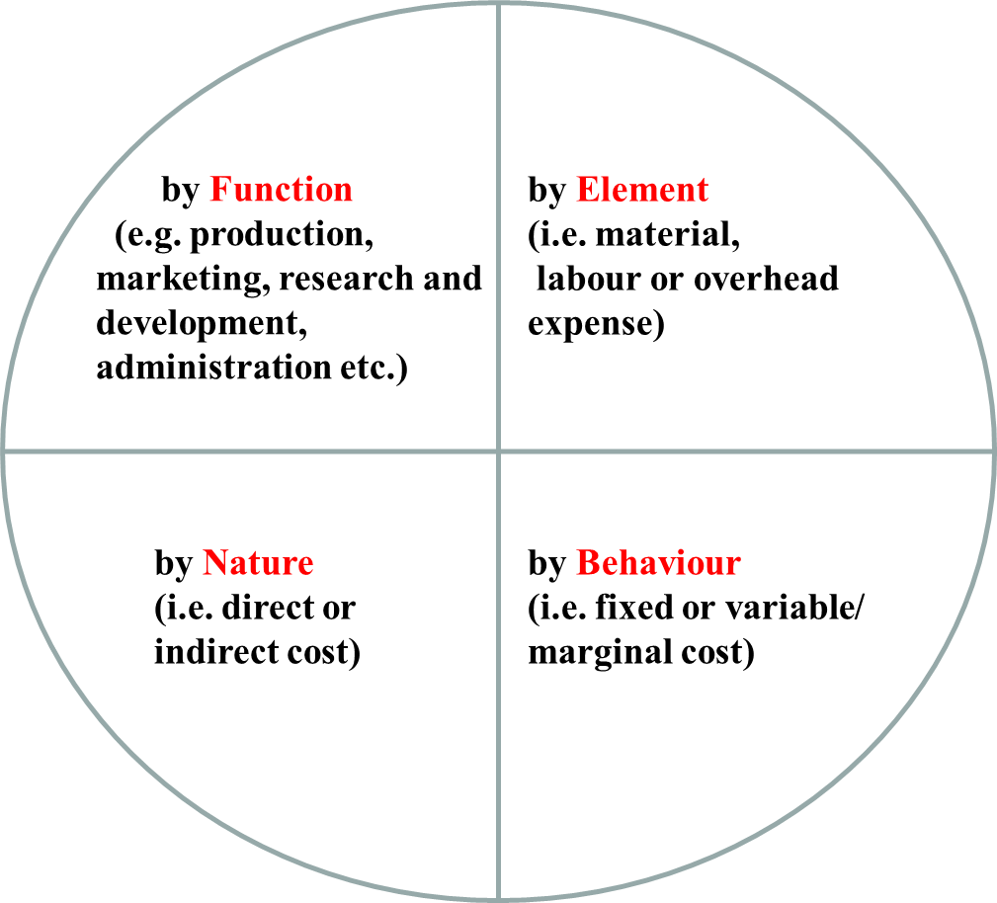
Cost classification

Slide 6
Direct and indirect costs
Direct costs
of a cost object are those that are related to a given cost object (product, department, etc.) and that can be traced to it in an economically feasible way.
Indirect costs
are related to the particular cost object but cannot be traced to it in an economically feasible way.

Slide 7
Direct and indirect costs
Limited Ltd has:
two production departments: Assembly and Finishing
two service departments: Maintenance and Personnel
Direct Costs: Indirect Costs:
Assembly Dep. €70,000 Maintenance Dep. €40,000
Finishing Dep. €50,000 Personnel Dep. €24,600
Assume that Maintenance Department costs are allocated equally among the production departments.
How much is allocated to each department?

Slide 8
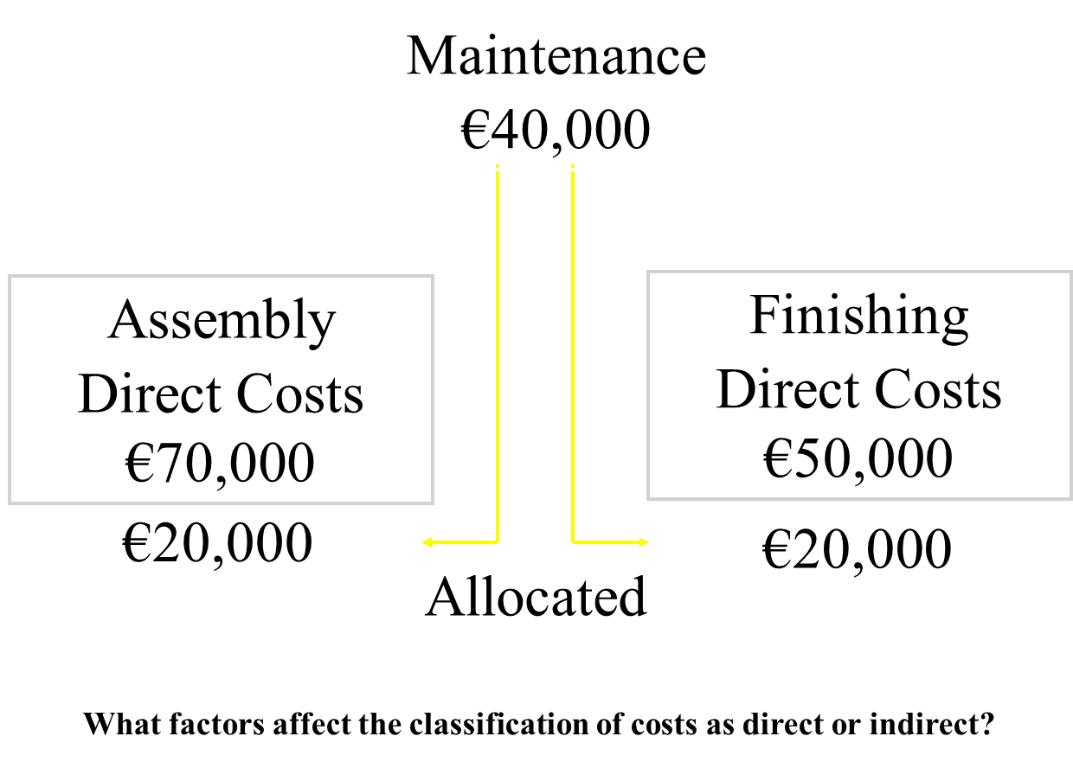
Direct and indirect costs

Slide 9
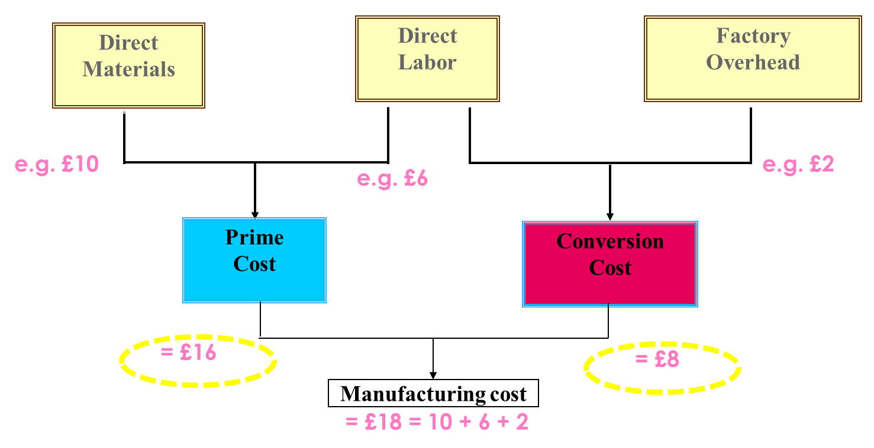
Direct and indirect costs

Slide 10
Absorption costing
Absorption costing is the method used to obtain the full cost of a product or a service.
This cost is then used for the inventory valuation in the Annual Report and can be used as a basis for determining the price for the product.

Slide 11
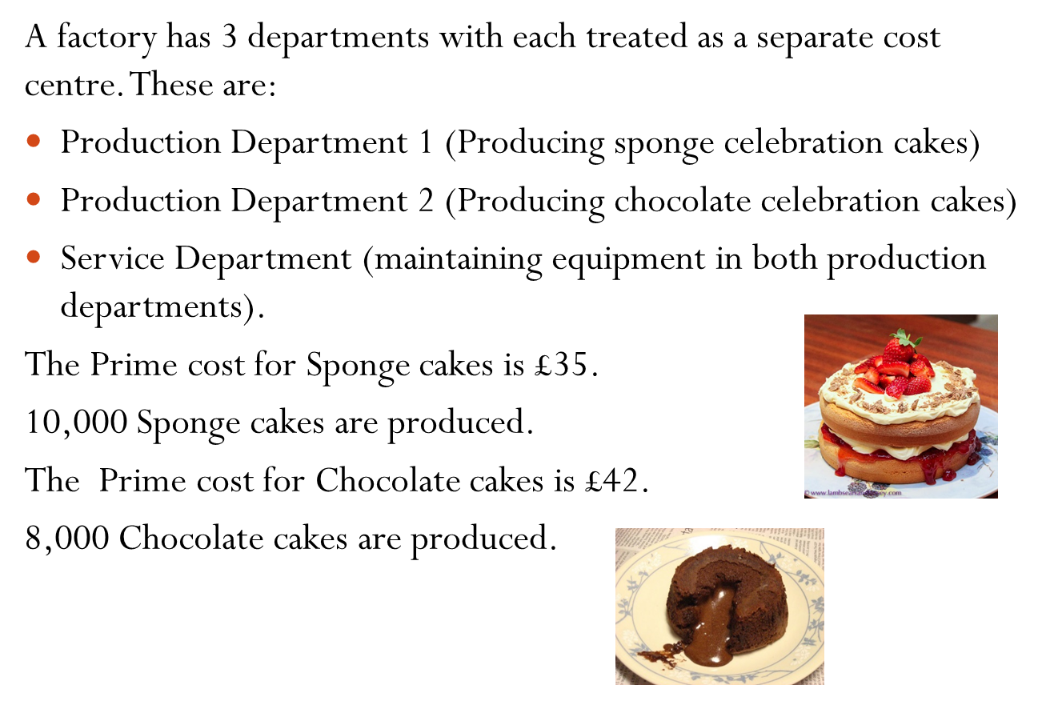
Example: Sponge and Chocolate

Slide 12
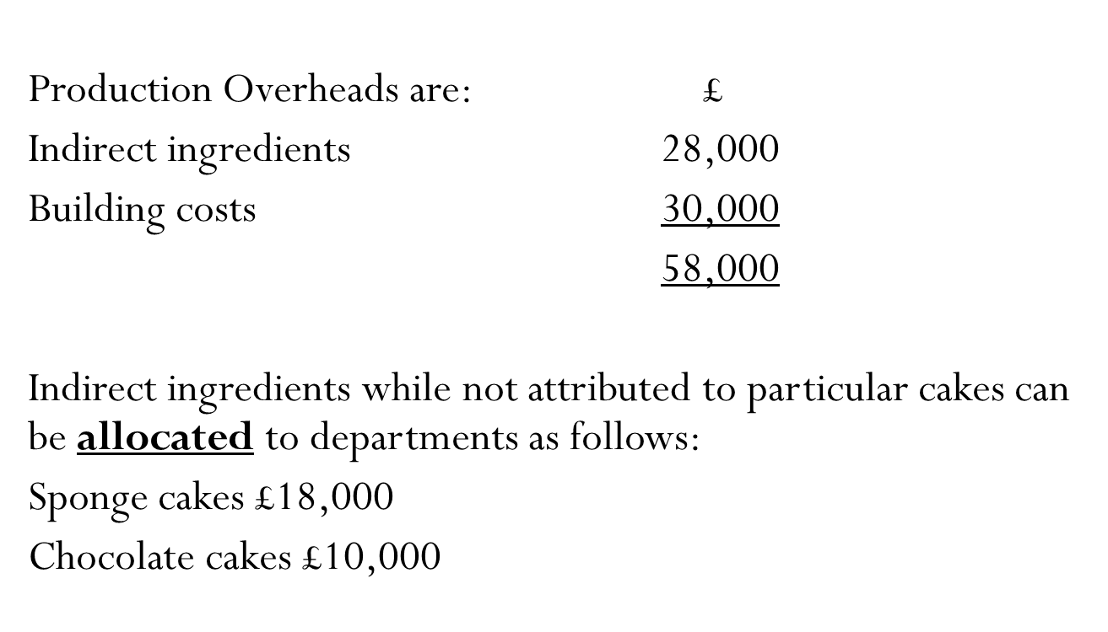
Example: Sponge and Chocolate

Slide 13
Example: Sponge and Chocolate
Having been able to allocate indirect ingredients to cost centres, the building costs must now be apportioned to the 3 cost centres. The management accountant will seek to apportion on the most realistic basis.
 | Department 1 Sponge | Department 2 Chocolate | Service Department Maintenance | Total
Area (sq metres) | 16,000 | 20,000 | 4,000 | 40,000
Value of plant £’000 | 500 | 750 | 0 | 1,250

Slide 14
Example: Sponge and Chocolate
The most realistic way for building costs of to be apportioned would be area.
The indirect building costs were £30,000
£30,000/40,000sq metres = £0.75 per square metre
 | Department 1 Sponge | Department 2 Chocolate | Service Department Maintenance | Total
Area (sq metres) | 16,000 | 20,000 | 4,000 | 40,000

Slide 15
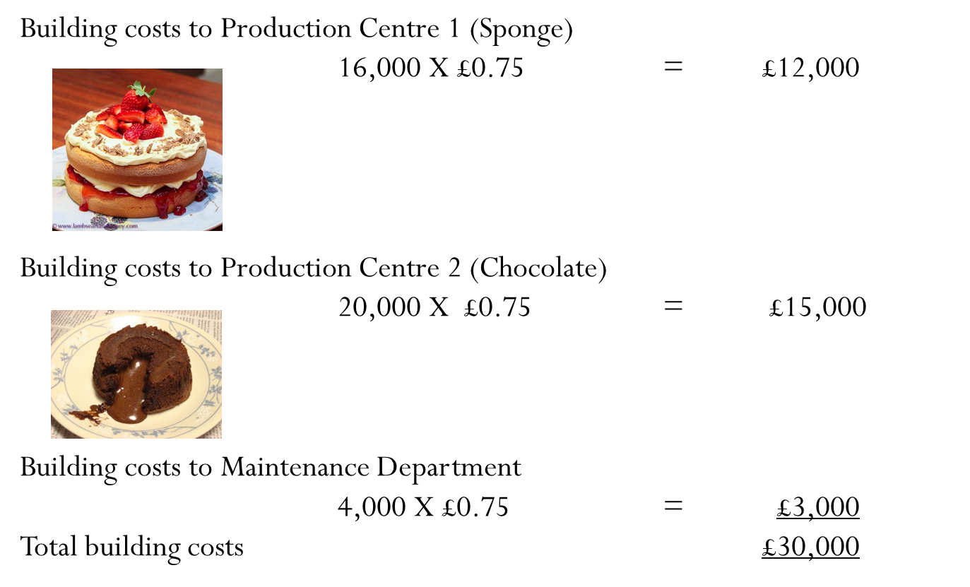
Example: Sponge and Chocolate

Slide 16
Example: Sponge and Chocolate
The indirect production costs/ overheads have now been allocated and apportioned to cost centres as follows:
Overheads | Department 1 Sponge | Department 2 Chocolate | Maintenance | Total
Indirect ingredients | 18,000 | 10,000 |  | 28,000
Building costs | 12,000 | 15,000 | 3,000 | 30,000
Total | 30,000 | 25,000 | 3,000 | 58,000

Slide 17
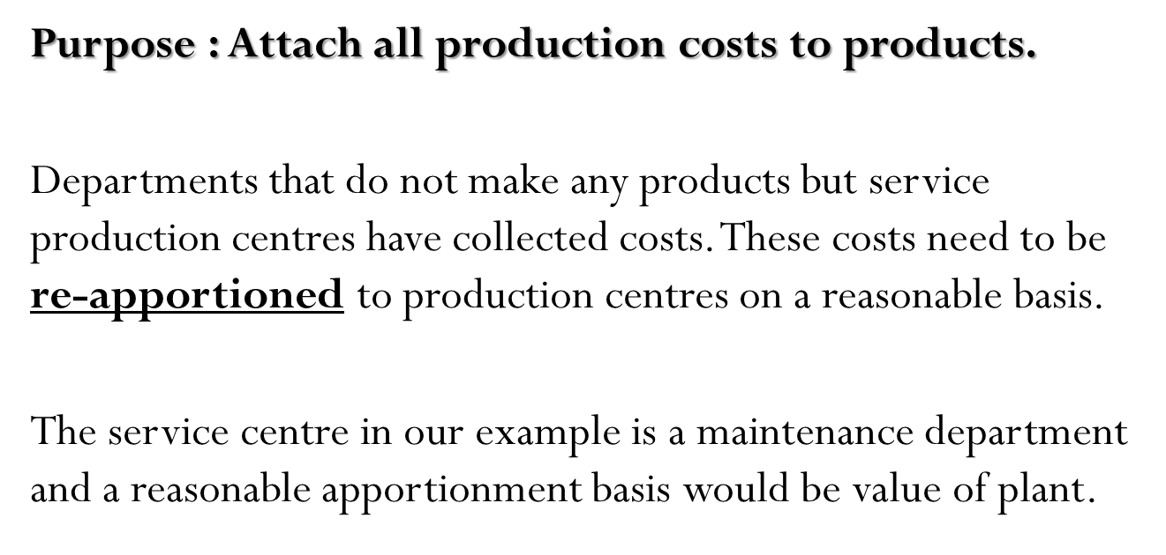
Example: Sponge and Chocolate

Slide 18
Example: Sponge and Chocolate
Maintenance has collected costs of £3,000 these are apportioned as follows:
£3,000/£1,250,000 = £0.0024 per £ of plant
 | Department 1 Sponge | Department 2 Chocolate | Service Department Maintenance | Total
Value of plant £’000 | 500 | 750 | 0 | 1,250

Slide 19
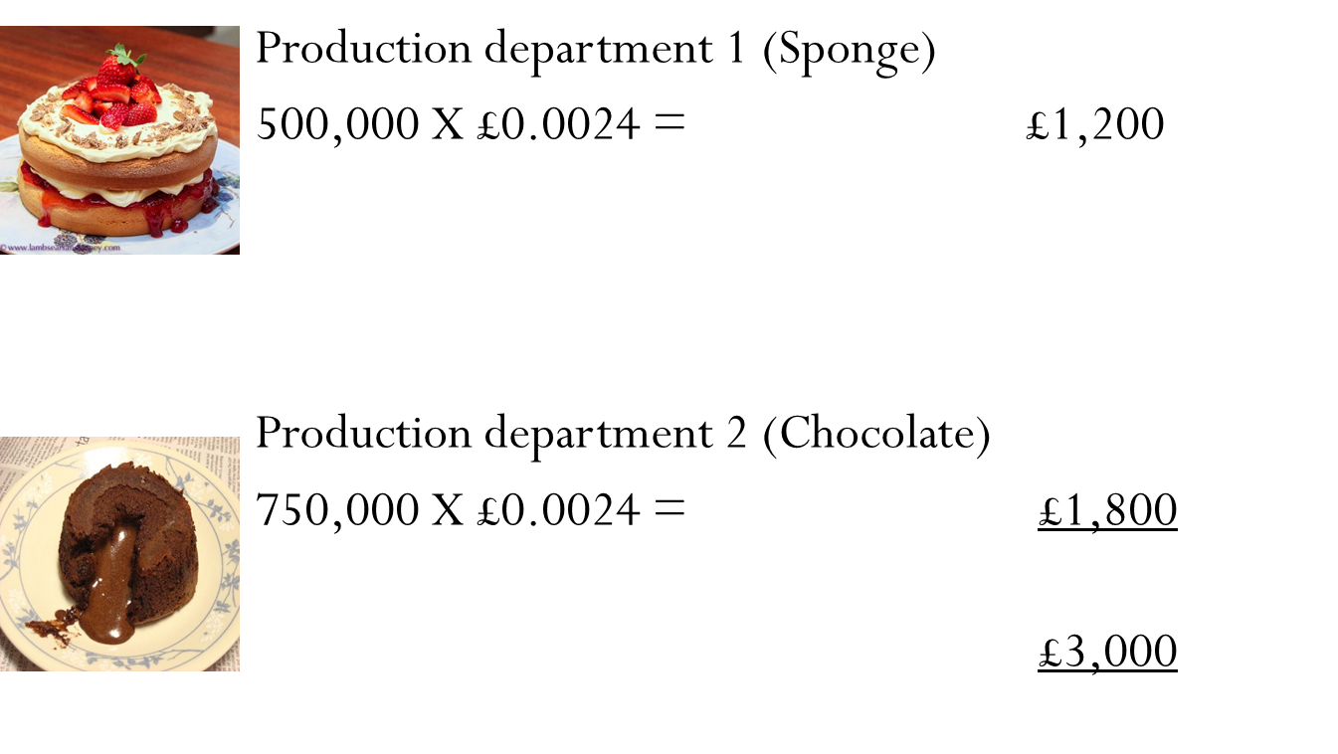
Example: Sponge and Chocolate

Slide 20
Example: Sponge and Chocolate
The indirect production costs/ overheads have now been allocated and apportioned to Production cost centres as follows:
 | Department 1 Sponge | Department 2 Chocolate
Indirect ingredients | 18,000 | 10,000
Building costs | 12,000 | 15,000
Total indirect costs | 30,000 | 25,000
Maintenance department | 1,200 | 1,800
Total | 31,200 | 26,800

Slide 21
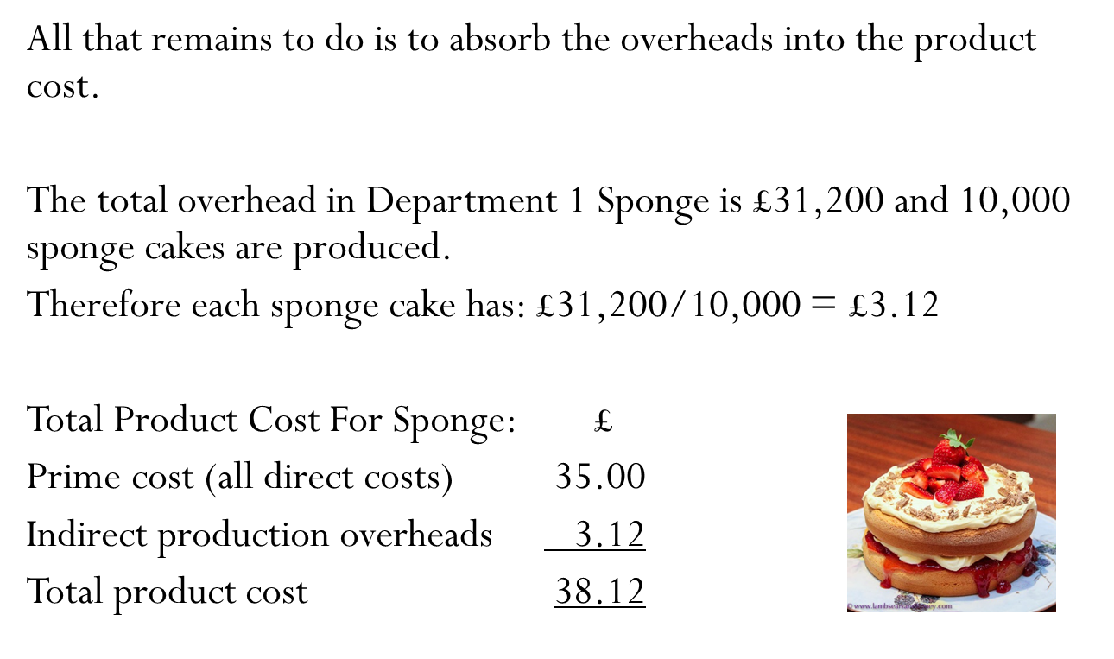
Example: Sponge and Chocolate

Slide 22
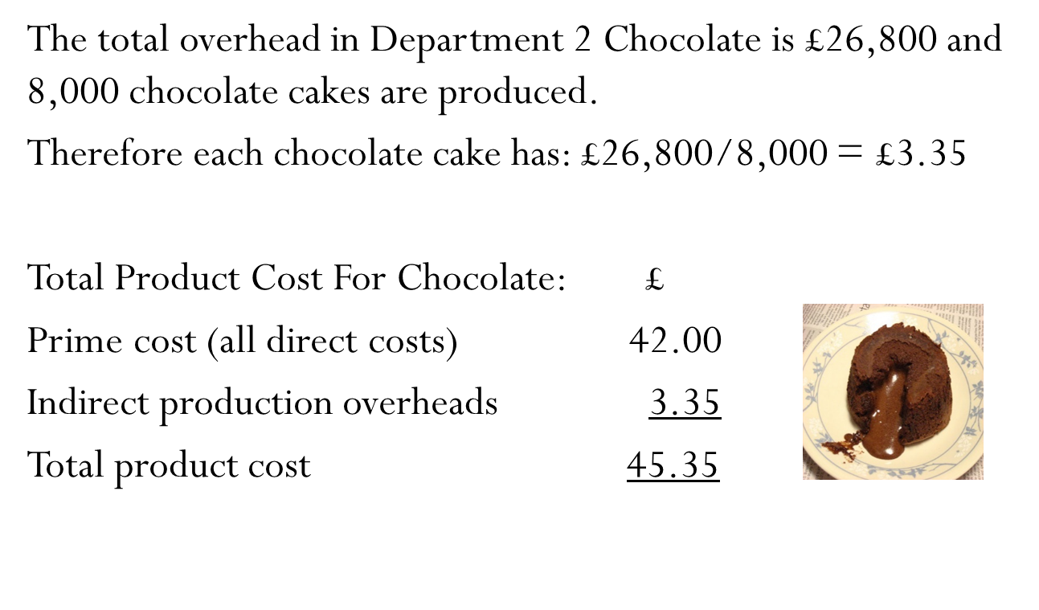
Example: Sponge and Chocolate

Slide 23
Example: Sponge and Chocolate
In the annual report the inventory valuation for sponge cakes will be £38.12 and for chocolate cakes £45.35.
In terms of pricing the company will add an appropriate percentage on for non-production costs and a profit margin
Cost
% for non-production cost
% for profit
Price

Slide 24
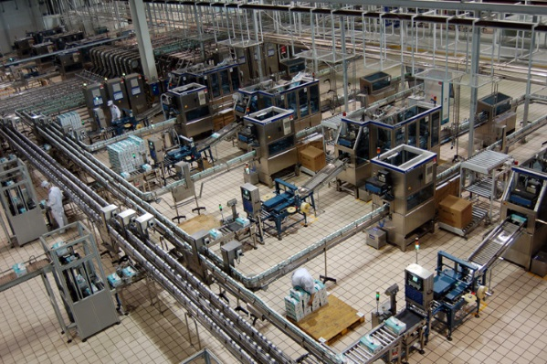
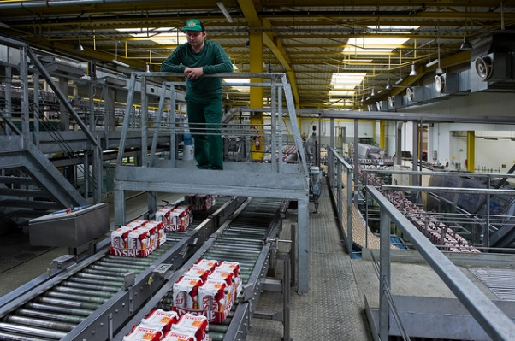
One product passing through two production centres
In the previous example the overhead absorption rate was the number of units produced as each department made one product from beginning to end.
In many industries a product may go through more than one production centre. In this case the overhead absorption rate may be machine hours or labour hours rather than units produced.

Slide 25
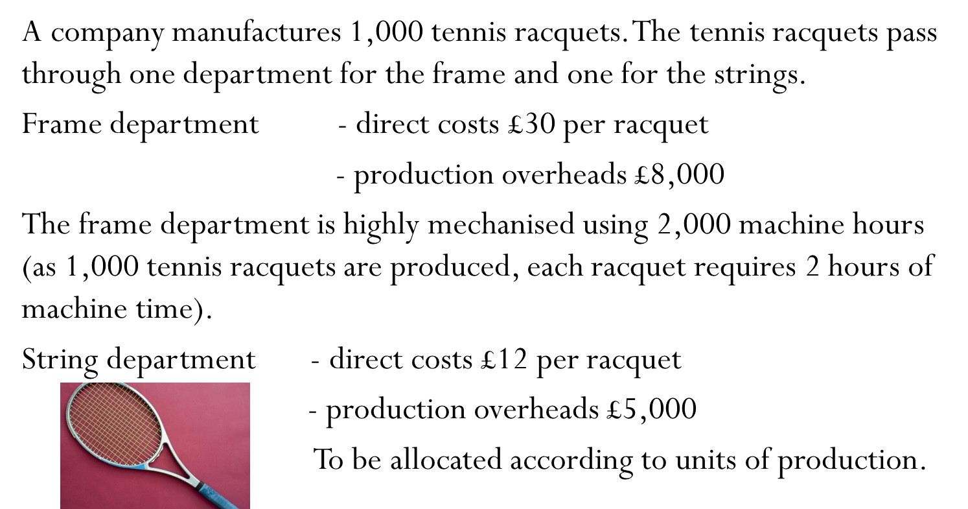
One product passing through two production centres

Slide 26
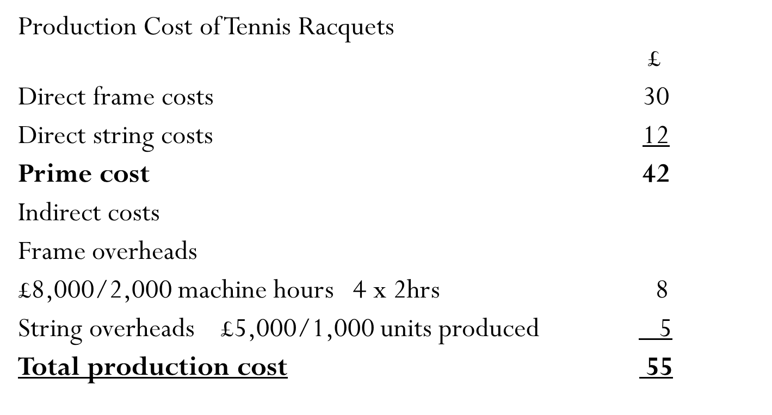
One product passing through two production centres

Slide 27
Reading (optional)
Gowthorpe: Chapters 11 and 12 (until page 237)

